Slide 1
JavaScript Overview
JavaScript for React
Notes:
Hello everyone and welcome to this lesson, where we are going to do a quick overview of JavaScript

Slide 2
Web development languages
HTML
Structure and content
CSS
Styling and layout
JavaScript
Dynamic interactivity
Notes:
The 3 core components of modern front end web development is HTML, CSS and JavaScript. HTML provides structure and content of the web page, while CSS adds on styling and layout so that the content is presented in a visually attractive manner. Finally, JavaScript allows the web page content to change dynamically in response to user interaction with it. For .e.g actions such as. the user moving the mouse over certain web content or clicking on specific elements on the page will cause certain elements to change in size, move, appear or disappear.

Slide 3
Intro to JavaScript
JavaScript is a lightweight, interpreted or JIT compiled programming language
Most well-known scripting language for web pages
All browsers have a JavaScript engine that executes JavaScript code
JavaScript can also be used to implement server programs (e.g. Node.js)
Notes:
JavaScript (JS) is a lightweight programming language that can either be interpreted or compiled before executed inside a browser. Early versions of JS were interpreted but the latest versions of the JavaScript engine in modern browsers such as Chrome, Edge, Firefox and Safari all use just-in-time or JIT compilation.
JavaScript is most well known as the primary (and in fact the only) scripting language for web pages at this point in time. All modern browsers have a special component called a JavaScript engine that performs JIT compilation and execution of JavaScript code. However, JavaScript has also found adoption in a multitude of environments and is also widely used to implement programs that run on servers. Servers are special programs that run on high end computers that provide all the web content that you get in your browser such as Youtube, Tik Tok, Twitter, Instagram and so on.

Slide 4
JavaScript versions
Created by Brendan Eich at Netscape in 1995
Adopted as a standard by ECMA in 1997 - ECMA262 standard for ECMAScript
2 main revisions (2009, 2015)
ES6 (ECMA2015) represents the most significant update to the language
Yearly additions since then (ECMA2016 – 2021)
Notes:
In 1995, JavaScript was created by a Netscape developer named Brendan Eich. It underwent several name changes: from the initial name of Mocha to LiveScript and then finally to JavaScript. The final name change was due to Netscape wanting to leverage on Java's fame at that point of time, although it is importat to stress that JavaScript is a very different language from Java as you will soon see in the upcoming labs.
In 1997, JavaScript 1.1 was submitted to the European Computer Manufacturers Association (ECMA) as a proposal. A technical committee was assigned to standardize the language to make it a general-purpose, cross-platform, and vendor-neutral scripting language. The standard for this was known as ECMA-262, and JavaScript is officially known as ECMAScript (often pronounced Ek-ma-script).
The first significant revision of the language was ES5 which was in 2009, and the second and what is considered the latest major update to the language is ES6 or ECMA2015. Although there have been yearly updates since then up to 2021, ES6 is considered by many developers as “Modern JavaScript” because of all the major additions that incorporated many new features that are widely used in all JavaScript programs created today. They allow the developer to write more concise and precise code, as we will see later in the upcoming labs.
ES6 is fully supported by the latest version of all major browsers (Chrome, Edge, Firefox and so on). The later versions have varying degrees of support for the newly introduced features, so to ensure that your JavaScript program can run on any browser, it is best to confine the feature set that you use to ES6 or ECMA2015

Slide 5
JavaScript engine
Core software component in the browser that executes JavaScript code
Early engines were pure interpreters
Modern-day engines use just-in-time (JIT) compilation for optimal performance
Runs in tandem with the rendering engine of the browser
Notes:
As mentioned earlier, the JavaScript engine is the Core software component in the browser that executes JavaScript code.
Early engines were pure interpreters; modern-day engines use just-in-time compilation for optimal performance. It runs in tandem with the rendering engine of the browser
Some common JavaScript engines include
V8 for Chrome, also used for Node.js. Chromium is the open source browser project headed by Google which is the basis for the Chrome browser.
Spidermonkey for Firefox used by Mozilla
JavaScriptCore for Safari used by Apple
Chakra for IE (but Edge uses Chromium now)

Slide 6
JavaScript engine
Some common JavaScript engines
V8 for Chrome (Chromium), also used for Node.js
Spidermonkey for Firefox
JavaScriptCore for Safari
Chakra for IE (but Edge uses Chromium now)
Notes:
Some common JavaScript engines include
V8 for Chrome, also used for Node.js. Chromium is the open source browser project headed by Google which is the basis for the Chrome browser.
Spidermonkey for Firefox used by Mozilla
JavaScriptCore for Safari used by Apple
Chakra for IE (but Edge uses Chromium now)

Slide 7


Notes:
JavaScript has over the years gained a reputation as a very versatile language that can used in a wide variety of domains and applications: from developing web applications to specialized libraries for machine learning, AI and also embedded devices in IoT scenarios.

Slide 8
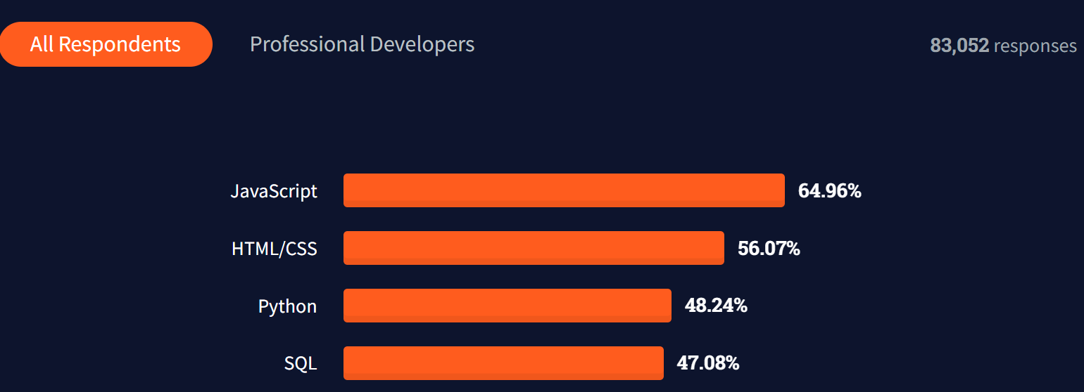
Stack overflow Survey 2021
Notes:
JavaScript currently ranks as the most widely used language on the latest StackOverflow developer survey, making it almost a prereqquisite skill for any software developer to have on their job resume. Notice as well that HTML/CSS ranks second.

